Slide 1

딥러닝 (Deep Learning)
Homework 5
Computer Vision using Deep Learning (Object Detection)

Slide 2

Programming assignments
Deep Learning Basic MLP
Object Recognition ResNet
Face Recognition Free choice model
NLU CNN for Sentence Classification
Object Detection YOLO
Image Generation GAN, CGAN, DCGAN
NLG LSTM, Transformer
SSL for Computer Vision ViT
SSL for NLP BERT
LLM ChatGPT

Slide 3
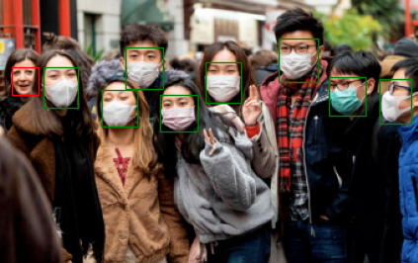
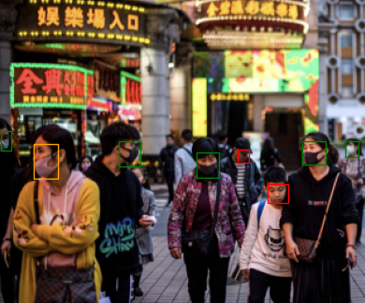
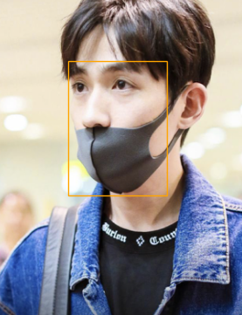
Assignment 5: Faster R-CNN for face mask detection
no mask - No mask at all.
improperly - Partially covered face.
mask - Mask covers the essential parts.
Data | Description | Target Class
Face mask detection | The dataset contains 853 images of people with and without masks. There are 3 different classes annotated. | 3

Slide 4
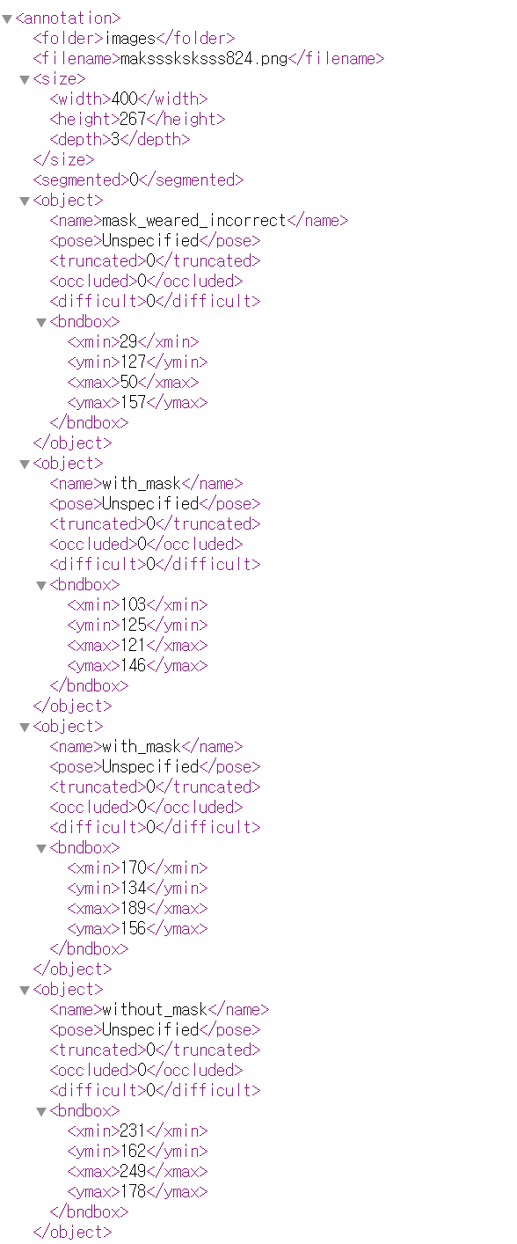
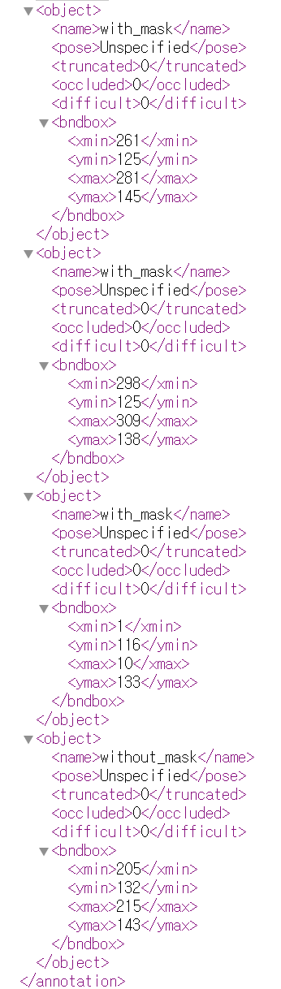
Assignment 5: Faster R-CNN for face mask detection
[data]

Slide 5
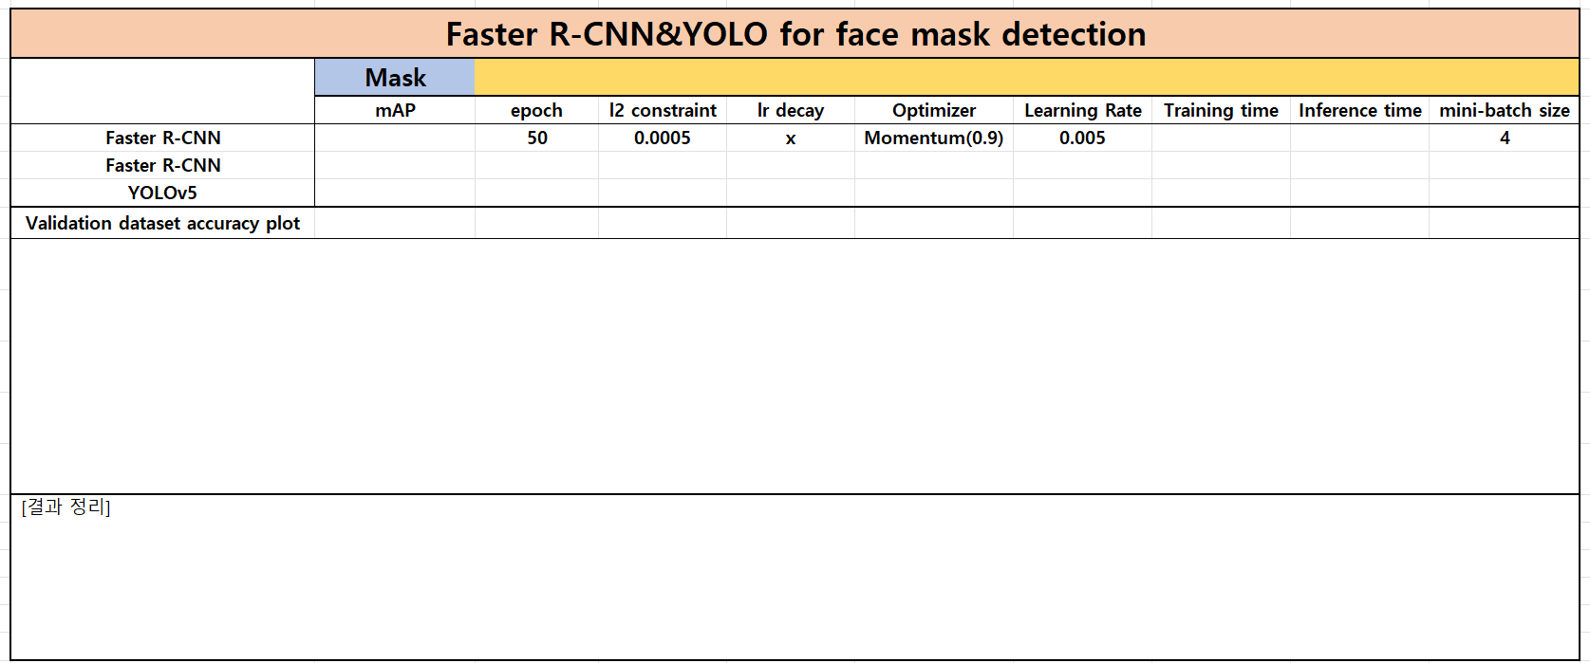
Assignment 5: Faster R-CNN for face mask detection

Slide 6
Assignment 5: Faster R-CNN for face mask detection
Evaluation Criteria
Simplicity | How concisely did you write the code? YOLO 모델로 수정: 3점 (model, MaskDataset 등)
Performance | How well did the results of the code perform? - 직접 찍은 사진 추론: 2점

Slide 7
Assignment 5: Faster R-CNN for face mask detection
Due to : ~ 5/7 (Wed) 23:59:59
Submission : Online submission on cybercampus
Your submission should include
The whole code of your implementation
The evaluation report
You must implement the components yourself!
File name : StudentID_Name_HW5.zip

Slide 8
Q&A

